Slide 1
EFFECT OF MECHANICAL Massage on labor pain in primi parturients
Shreya Rup Roy . Nagajyothi R. . Vidyashankar Iyer

Slide 2
CONTENTS
INTRODUCTION
ABOUT THE DATA
GRAPHICAL REPRESENTATION
ANOVA
NON PARAMETRIC TESTS
CONCLUSION

Slide 3
introduction

Slide 4
Aim of the project is to assess the effectiveness of mechanical massage on perceived labor pain among primi parturients at active labor

Slide 5
about the study
The research design adopted for the present study was a randomized controlled trial. Data was collected at the clean labor room, WCH, JIPMER hospital, Puducherry for 6 weeks.

Slide 6
In this study, the target population refers to all the primi parturients mothers.
The accessible population in this study refers to all the primi parturients mothers in an active stage of labor who are admitted to CLR for normal vaginal delivery at WCH, JIPMER.
It includes two study sample groups of primi gravida women at term in active labor who are undergone vaginal delivery in CLR, WCH, and JIPMER during data collection:
Control group : The mother in the control group will receive routine care of Inj-tramadol 50mg IM.
Experimental group : Parturient mothers in the intervention group will be receiving both routine care and mechanical massage. Mechanical massage will be provided uniformly in the lumbosacral area of primi parturients after 4-5 cm cervical dilatation for 15 minutes up to 3 times through the use of massage glove.

Slide 7
Sample size is estimated using the statistical formula for the comparison of two independent means for minimum expected difference in the mean change as 2 units, sd as 3 units at 5% level of significance and 90% power. N = 53 in each group with total number of samples = 106 with 10% attrition.
Inclusion Criteria
Primi parturients:
with a Singleton pregnancy
term pregnancy with Vertex presentation
in Active Stage of labor (>4cm)
Exclusion criteria :
Primi parturients with medical or obstetrical co-morbidities.
In a Numerical Pain Rating Scale (NPRS), patients are asked to circle the number between 0 and 10. Zero usually represents 'no pain at all', whereas the upper limit represents 'the worst pain ever possible.

Slide 8
About the data

Slide 9
VARIABLES
sl no: Serial Number.
unique_id: Unique id number that identifies each subject uniquely.
Group: Indicates whether the subject belongs to the Control Group (1) or Intervention Group (2).
Age: Age of the subject
Area of residency: Indicates whether the subject comes from a Rural Area (1) or Urban Area (2).
Education: Indicates the education status of the subject: Primary (1), Secondary (2) or Graduated (3).
Occupation: Indicates the occupation status of the subject: Housewife (0) or Working (1).
Family type: Indicates the family type of the subject: Nuclear family (1) or Joint family (2).

Slide 10
Gestation week: Total Gestation period in weeks.
Uterine contraction: Indicates the severity of contraction – Mild (1), Moderate (2) or Severe (3)
Expected fetal weight: Expected fetal weight in kg.
No of antenatal visit: Number of antenatal visits.
Method of conception: Indicates the method of conception – Spontaneous (1) or Ovulation Induction (2)
Type of labor: Indicates whether the labor experienced by the subject was Spontaneous (1) or Induced (2)
Oxytocin Augmentation: Indicates whether Oxytocin Augmentation in the subject is Absent (0) or Present (1).
Pre test pain score: Pain experienced by the subject on the scale of 1-10 before the test.
Pre test pain score: Pain experienced by the subject on the scale of 1-10 after the test.
Difference: Post test pain score – Pre test pain score

Slide 11
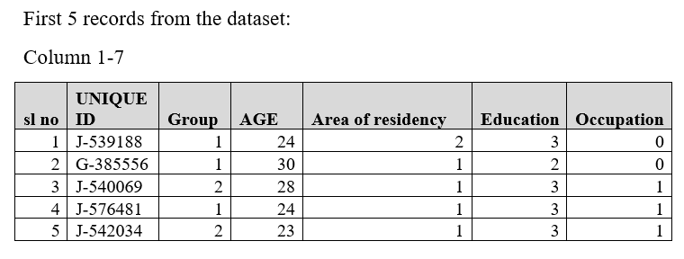
Specimen data

Slide 12
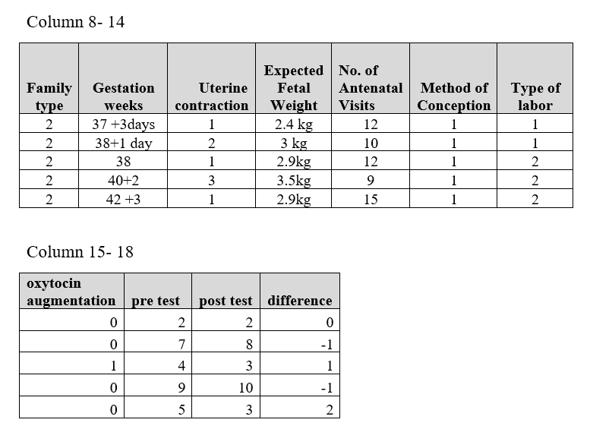

Slide 13
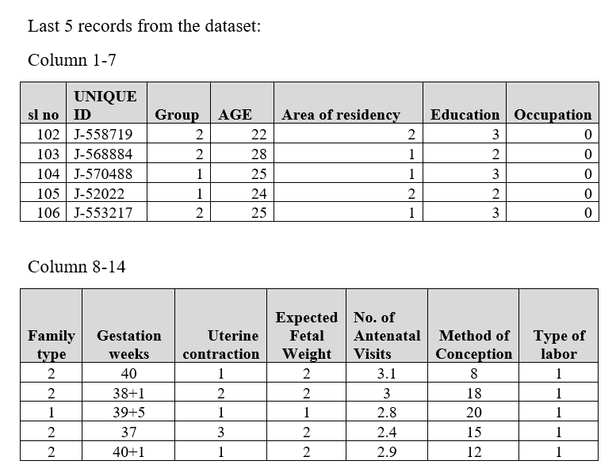

Slide 14
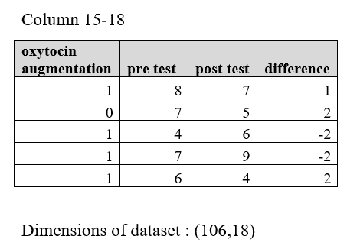

Slide 15
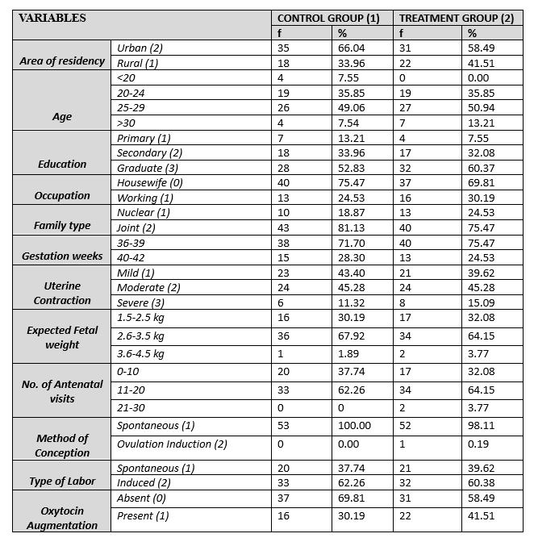

Slide 16
Graphical representations

Slide 18
Area of residence
Education
Occupation
Type of family

Slide 19
Type of labor

Slide 20
ANALYSIS

Slide 21
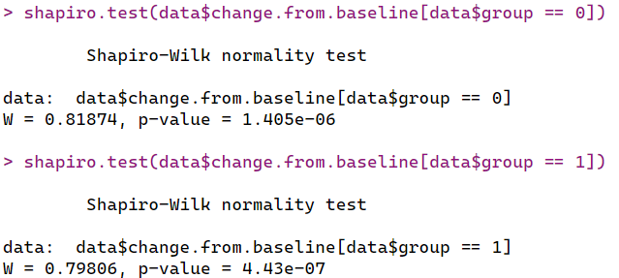
Before heading towards the analysis, we need to make sure that the change from baseline variable satisfies normality or not. Only based on its result, we can decide on whether to proceed with parametric tests or non parametric tests.
Based on the results it was concluded that change from baseline in both the groups are non-normal.
*Group ‘0’ denotes the control group and group ‘1’ denotes the treatment group
Before getting into the analysis, it is important to notice how well are the variables associated with each other. Since most of the variables are categorical, correlation would not be the right measure here. Hence, we make use of the chi-square test. Based on the results, we could see that attributes type of labor and oxytocin augmentation have a strong association at 5% level of significance.

Slide 22
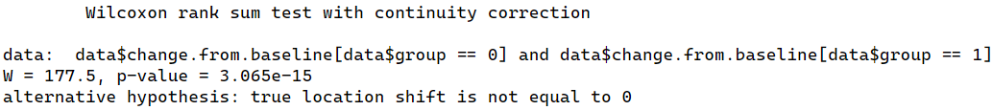
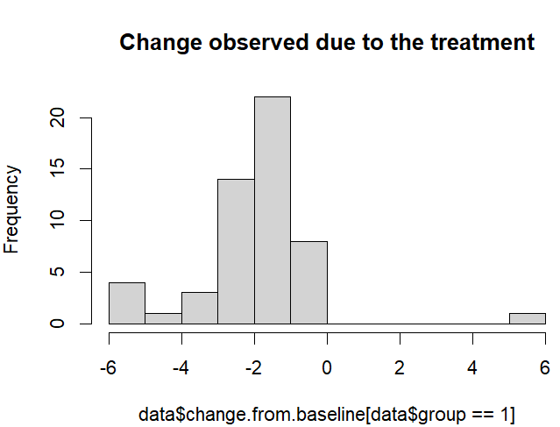
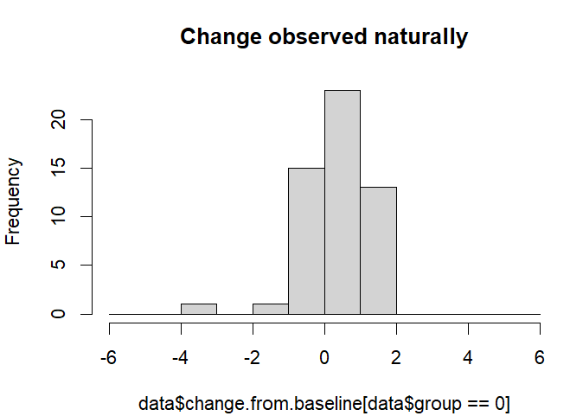
Primary objective of the test is to check whether the treatment is effective or not. Hence, we compare the mean change from baseline in both the groups and hence decide. Mann Whitney U test
p-value < 0.05 indicates that at 5% level of significance the change from baseline is significantly different for both the groups. We also observe the median change in the controlled group is 1 and treatment group is -1. Negative change in treatment group is a sign of its good effect on the patients.

Slide 23
Let us understand about the results observed in the treatment group. A few highlights here are:
Almost 2/3rd of the women in this group are housewives.
Almost 76% of the women belong to joint families.
Only one case of Ovulation Induction was observed in the whole data and that belongs to this group. The subject has experienced a relief in terms of pain which is indicated by the change from baseline -2.
The allocation of subjects to the treatment group doesn’t look suspicious or is fine as the distribution of subjects among different classes of each attribute is almost same in both control as well as treatment groups.
The question now to be addressed is whether the effect of the treatment, which is found to cause relief, really very helpful for the patients.? Which means, Is it really a necessary procedure to perform this treatment to the targeted sector of mothers?
We shall find that out.

Slide 24
Change from Baseline pain score ranges from -6 to 6 in this group, which indicate 2 extremely opposite natures of the treatment. If -6 indicates a very good relief, then 6 indicates significant increase in pain.
The histogram seen earlier suggests that the data is negatively skewed i.e., the values of the change from baseline are highly concentrated in -6 to 0 region. Only one observation of this change is observed to be greater than 0. Let us consider that the treatment is success if the change is at least -2. Then the odds of success is 0.7097 or 70.97% with success probability 0.415 or 41.5% which is a promising result given that there are no side effects.

Slide 25
CONCLUSION

Slide 26
Treatment does act as a relief factor among mothers.
Working women have felt comparatively more relief. Especially Urban mothers need the treatment as compared to Rural mothers.
When the subject is admitted, the uterine contraction is the only factor that influences the labor pain.
The post test pain score and difference is influenced by the factors group and education.

Slide 27
Scope for improvement and further study
Scoring method
Insufficient data of different methods of conception
Study effect of lifestyle on the necessity for the treatment
Review on how the treatment felt might be helpful

Slide 28


